Slide 1
Local Listing Campaign: Tattered Cover Book Store
Prepared by
Adam Mohrbacher
SEM Marketing

Slide 2
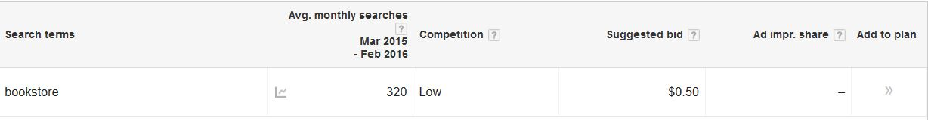
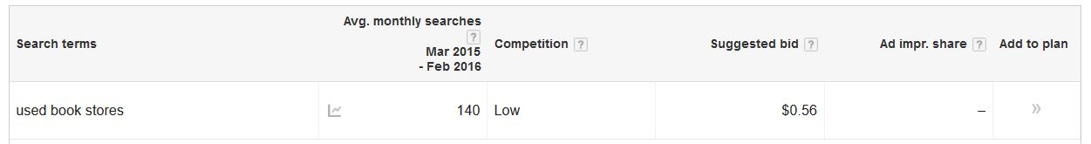
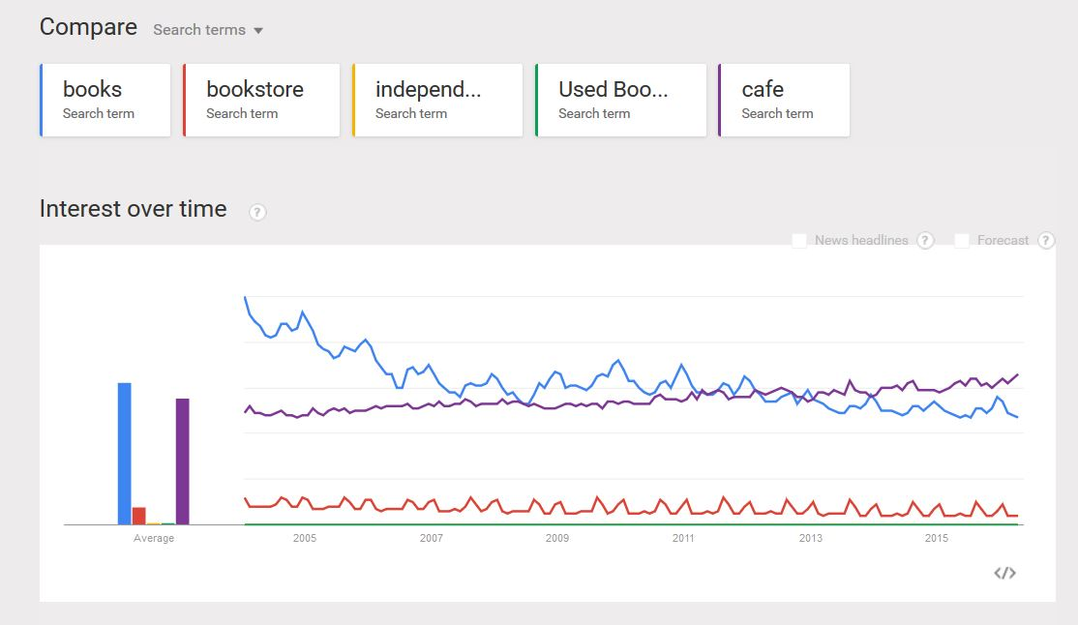
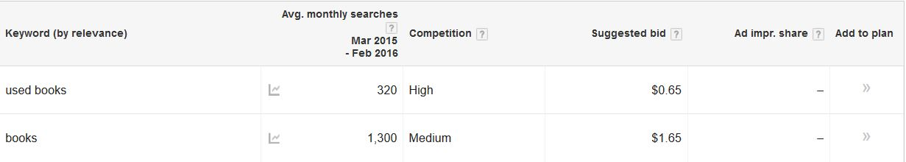
KEYWORD SELECTION
Books
Bookstore
Cafe
Used book stores
Used books
- Conducted local searches for keywords. Chose keywords based on the business focuses of Tattered Cover, average searches, competition and cost. Also, I utilized Google Trends.

Slide 3
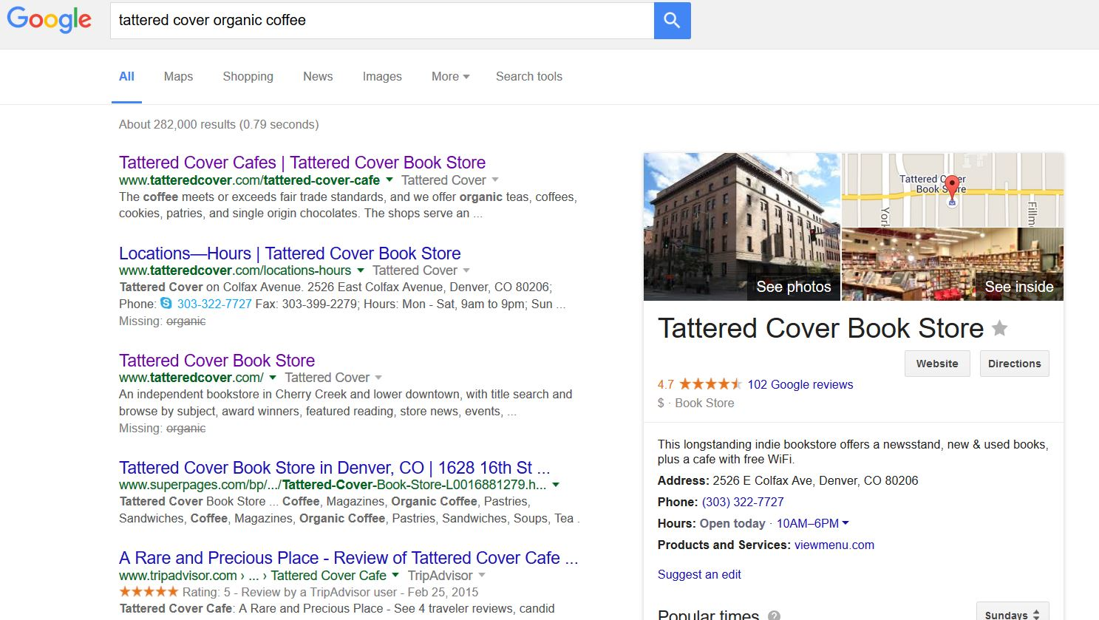
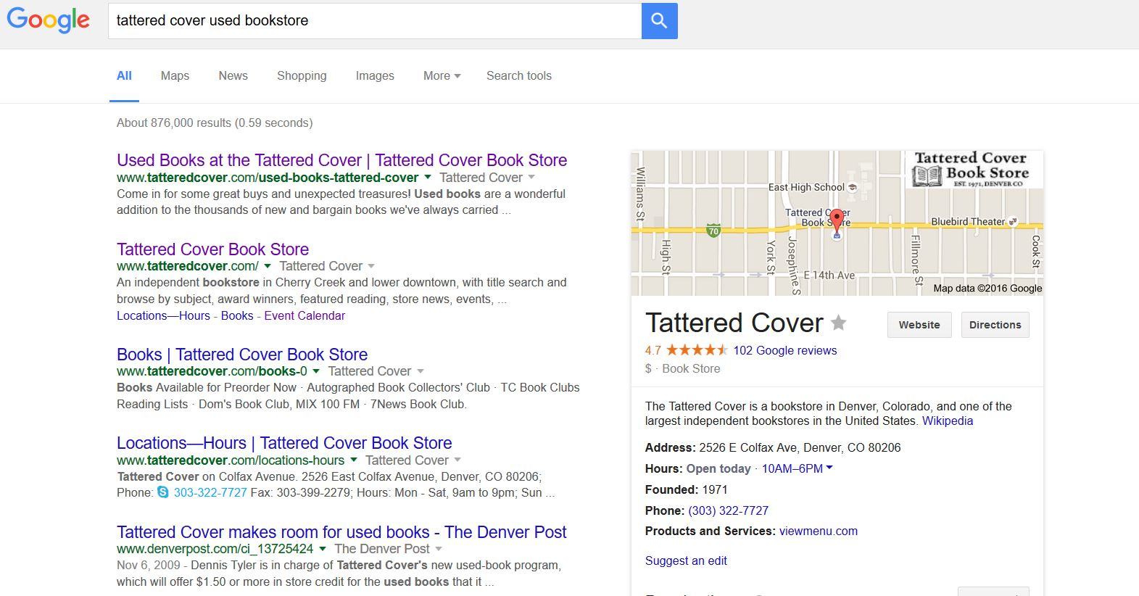
Baseline Accuracy Report
Tattered Cover’s Address for Colfax Location: 2526 E. Colfax Ave. Denver, CO 80246
I conducted branded searches for each of my keywords
Each search produced accurate results, listing Tattered Cover’s Colfax location information.

Slide 4
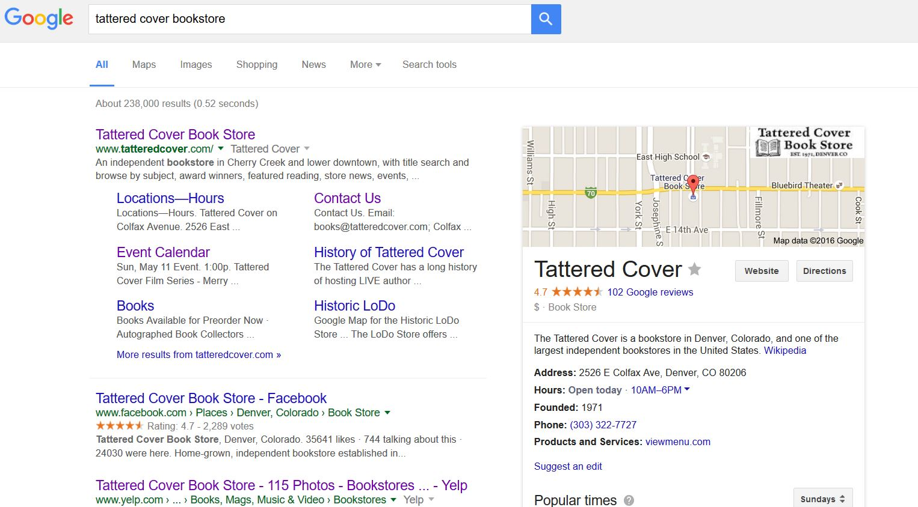
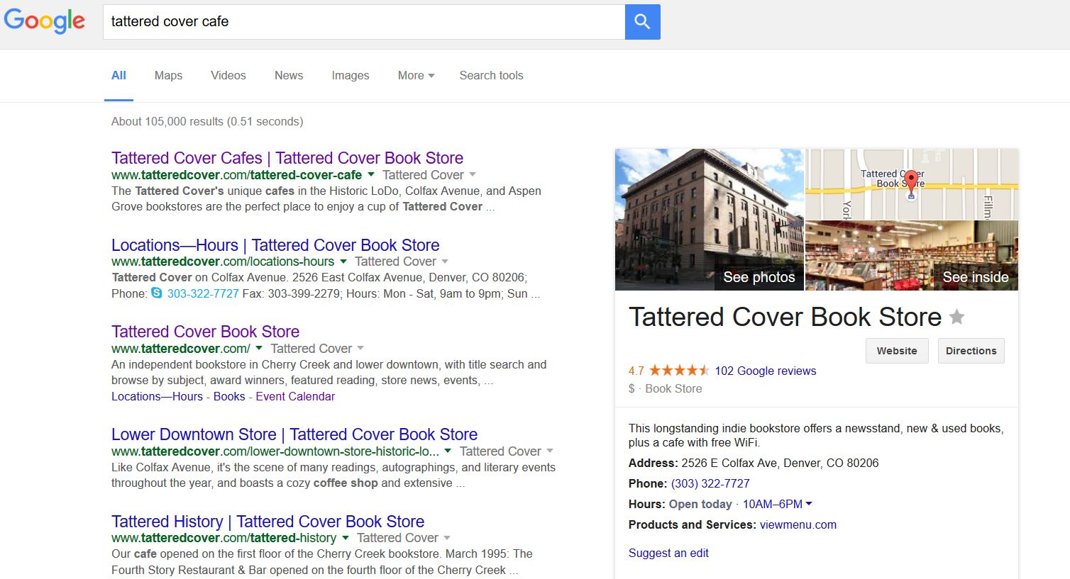
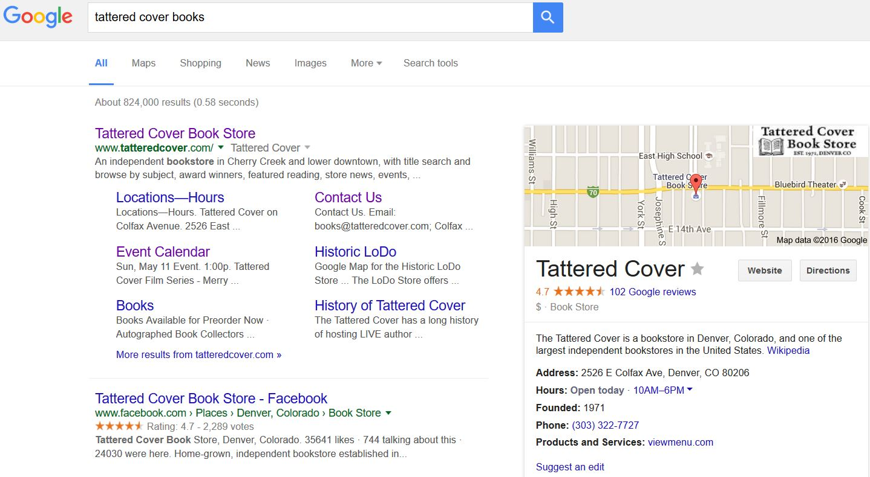
Baseline Accuracy Report (Continued)

Slide 5
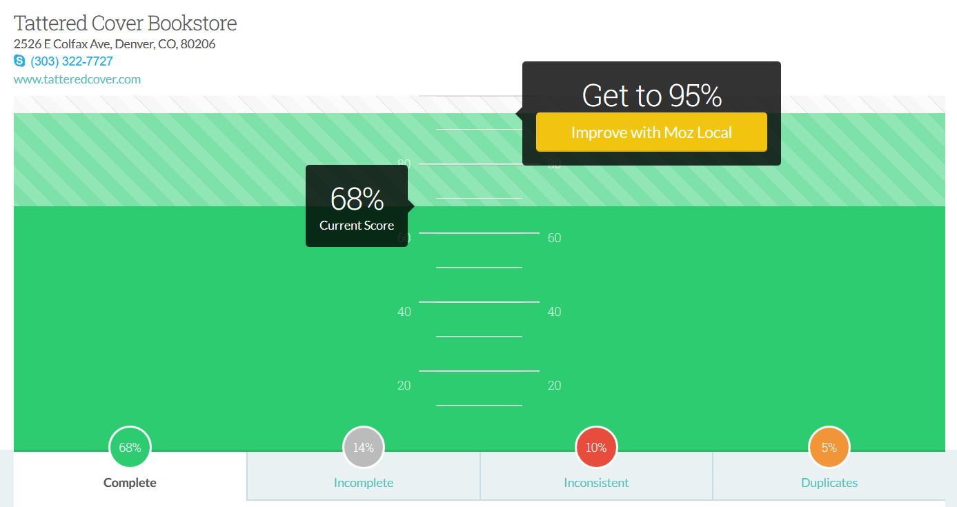
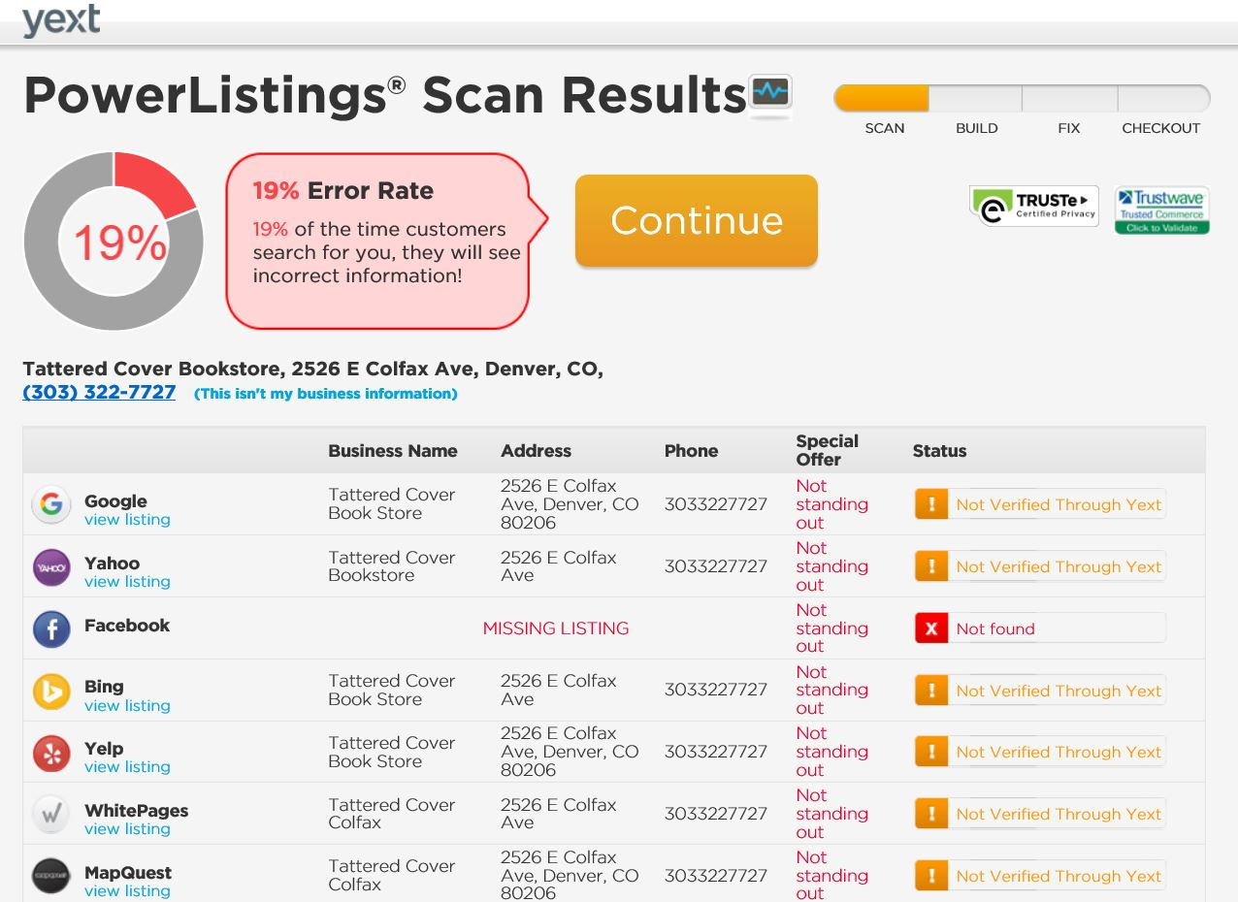
Baseline Accuracy Report (Continued – Part II)
Moz and Yext: Conducting an accuracy audit provided me with several insights on how consistently Tattered Cover’s Colfax location is listed accurately on the Internet.
- While in many case Tattered Cover is listed correctly and completely, there are other locations on the web where the store has incomplete information.

Slide 6
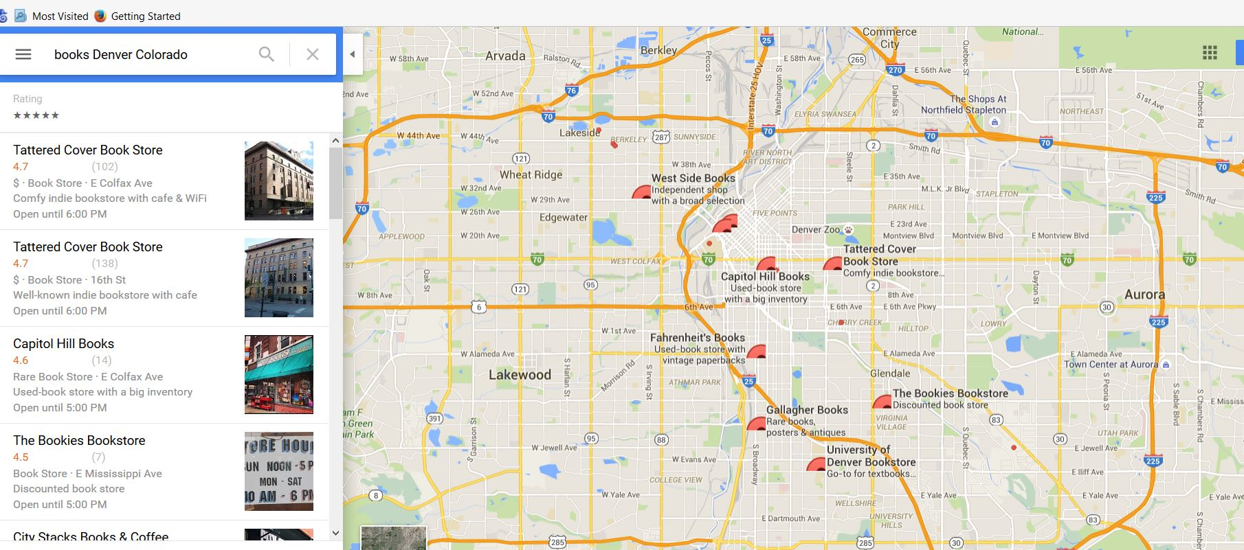
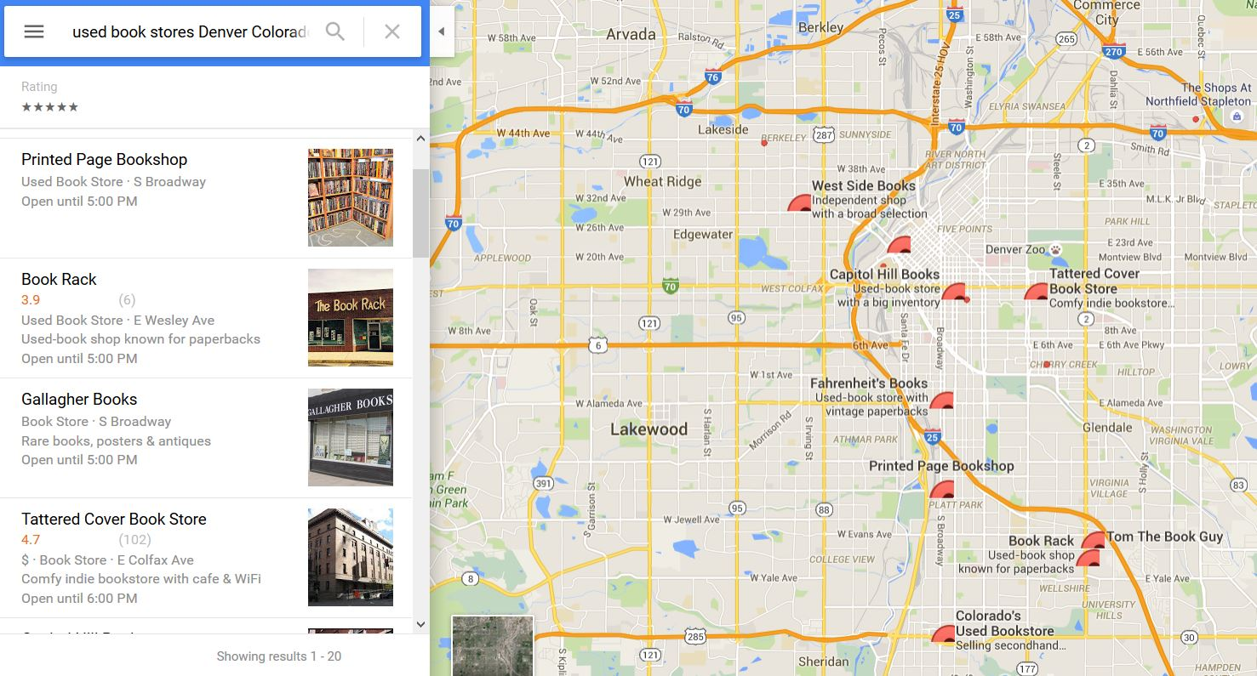
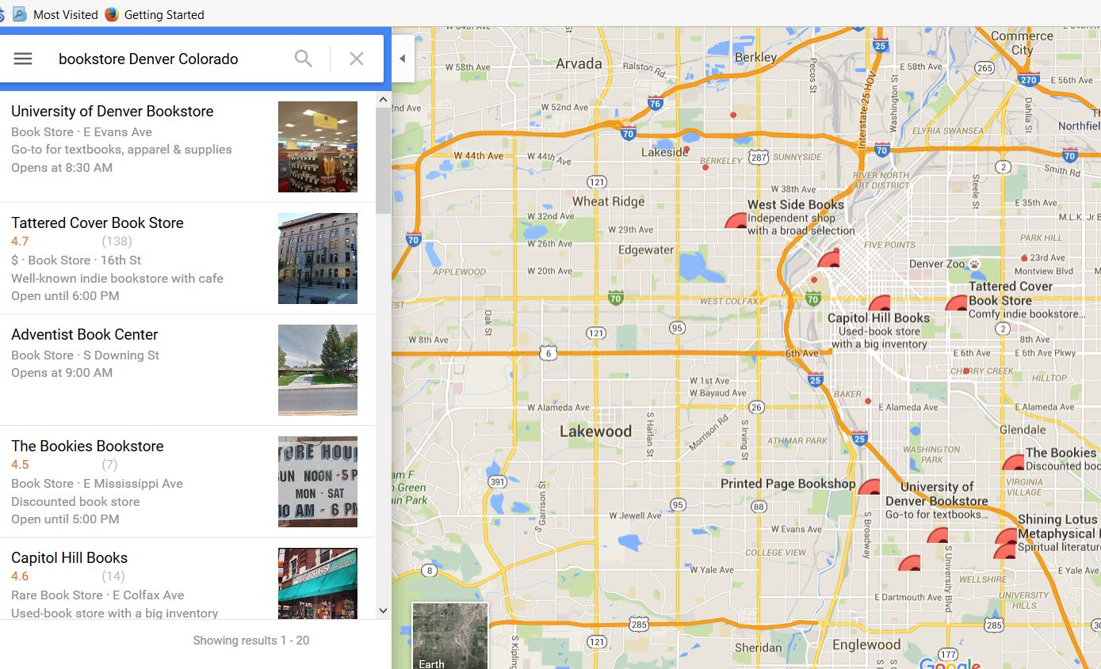
Baseline Ranking Report – Google – part I
Fifth one ranked
First one ranked
Second one ranked

Slide 7
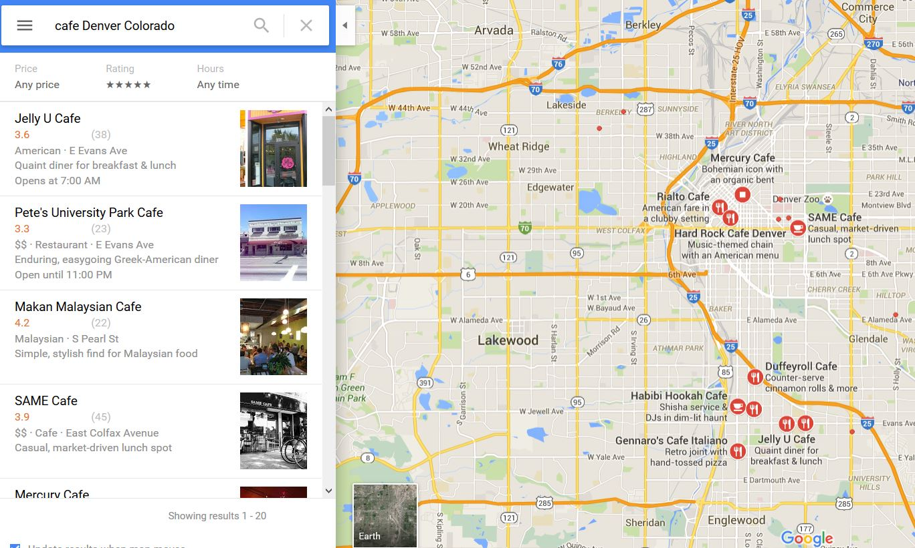
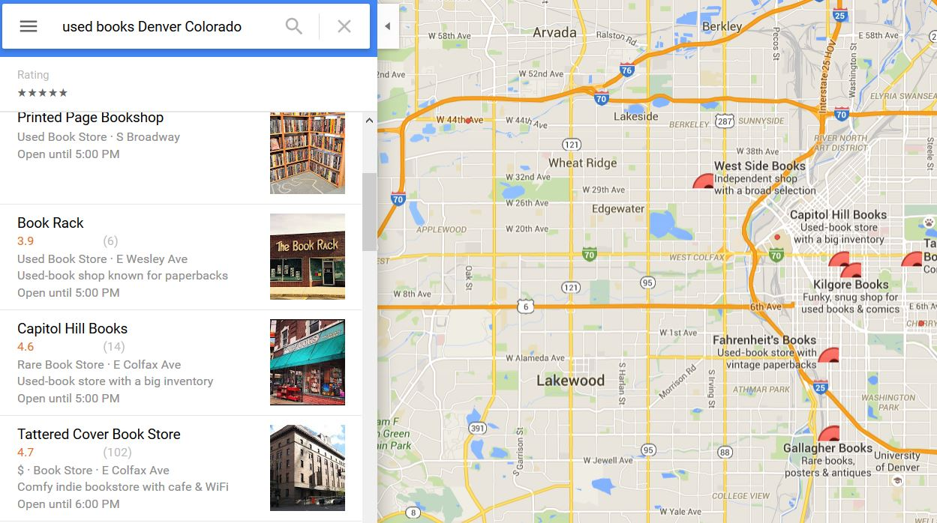
RANKING REPORT – GOOGLE – Part II
Not listed in top 20
Listed seventh

Slide 8
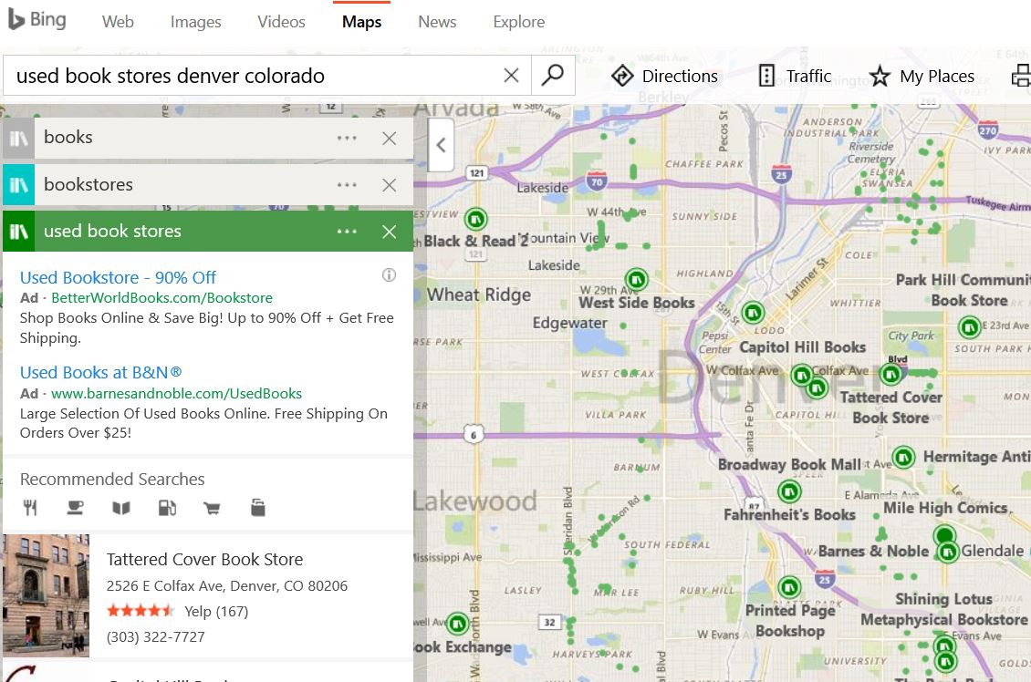
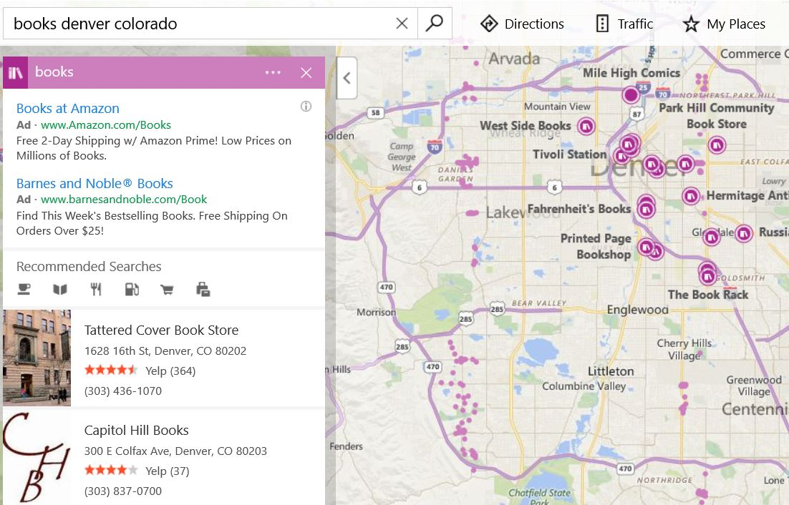
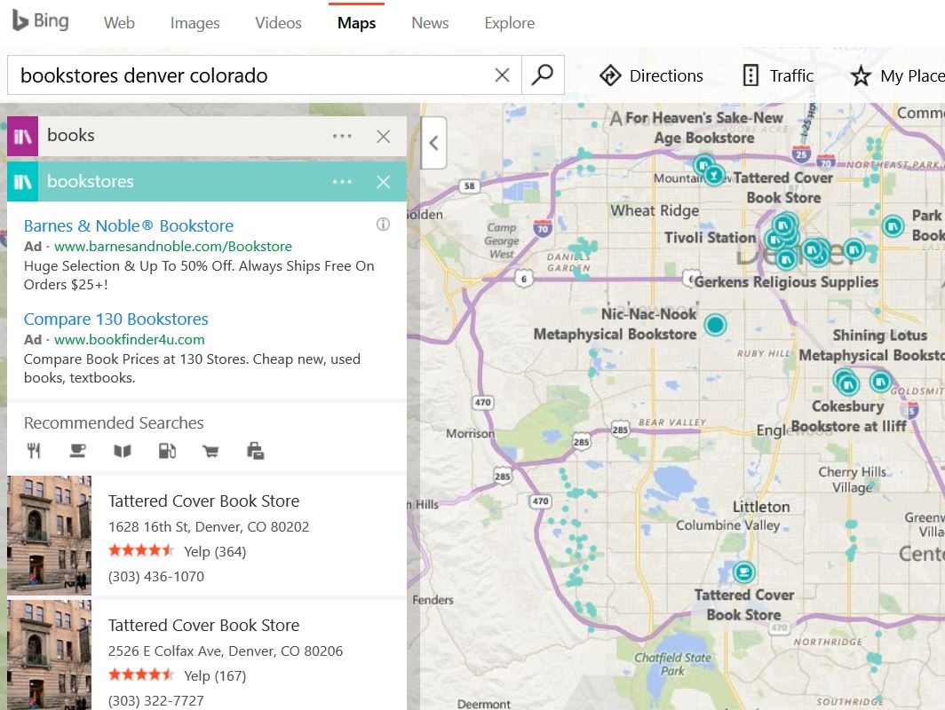
Ranking Report – BING – PART I
Ranked first
Ranked third
Ranked second

Slide 9
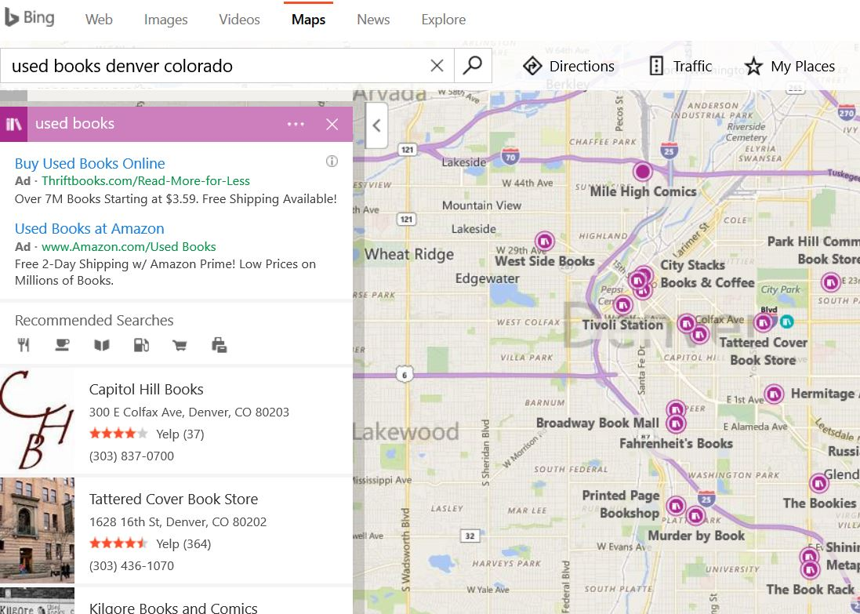
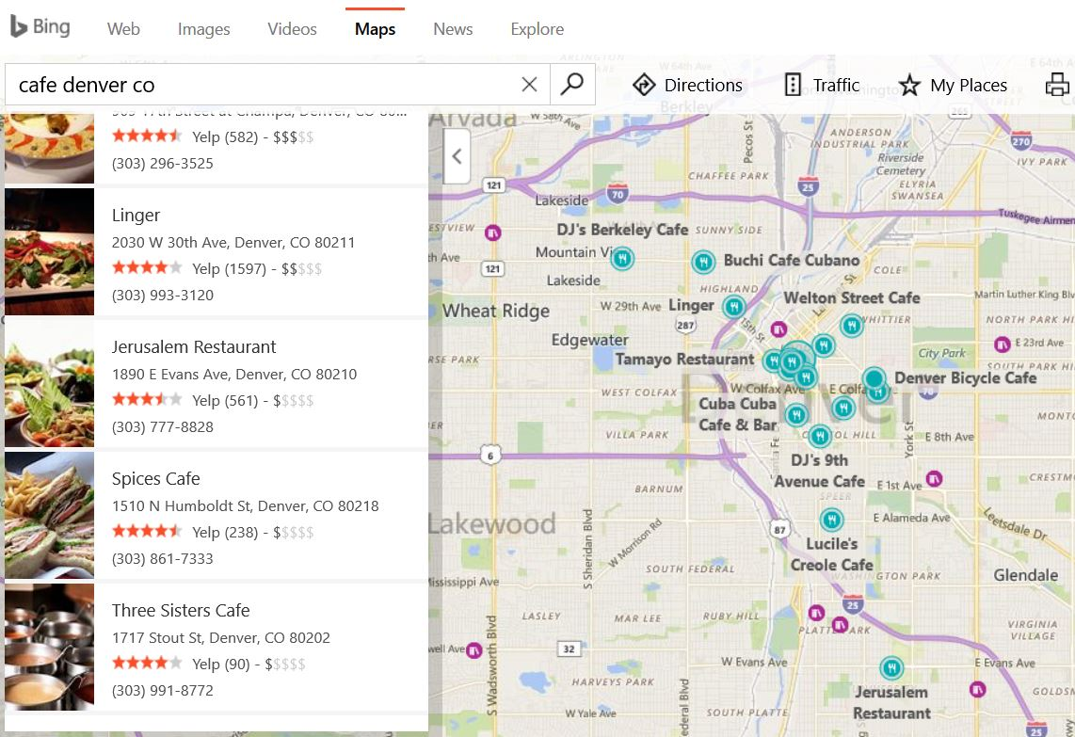
Ranking Report – BING – PART II
Not listed
Colfax location not listed

Slide 10
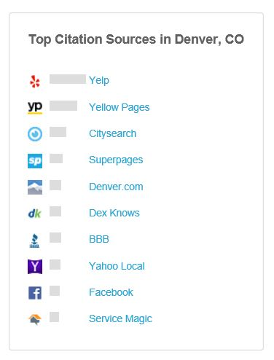
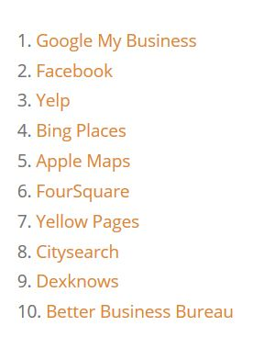
Citation Opportunities
In looking through the top citation sources (on Moz and Vertical Measures) I learned the following things:
  Tattered Cover’s Colfax location is not listed on Yellow pages.
  Colfax location is not listed on Dex Knows.
  It also isn’t on Yahoo Local.
  It has an incomplete profile on Citysearch
Moz Top Citations
- Conducting NAP searches of my business did not yield any new opportunities.
However, by conducting NAP searches of one of Tattered Cover’s competitors I learned the following:
  On the website “Hours and Info” Barnes and Noble is listed and Tattered Cover is not.
- It is recommended that Tattered Cover pursue listing or improving their listings with all five of these sites. Yellow Pages, Yahoo Local, Dex Knows and Hours and Info are all free. Yellow Pages, Dex Knows, Citysearch and Yahoo Local are also all top citation sources for the Denver metro.
Vertical Measures
Top Citations

Slide 11
Appendix
http://www.hoursinfo.com/business-submit/
  Web location for where you can submit to Hours/Info.
https://moz.com/learn/local/citations-by-city
  Moz city citations rankings, which I used as a launching pad to find new opportunities for Tattered Cover’s Colfax location.
http://www.tatteredcover.com/detailed-history-tattered-cover
  Main site of business which I referred to determine categorical focuses.
http://www.verticalmeasures.com/local/10-good-local-citations-you-can-get-right-now/
  Vertical Measures article on great citation locations; used as a reference for my proposals
http://www.yellowpages.com.au/pages/help/advertisers
  Location where Tattered Cover can freely submit to Yellow Pages.
https://www.yext.com/pl/powerlistings/populate
  Yext ranking for Tattered Cover’s citations

