Slide 1
Right Start PPC Campaign
Prepared by Adam Mohrbacher
SEM Marketing
Prof. Nick NEELS

Slide 2
Keywords
Keywords were chosen by examining the existing Right Start’s Baby Vista Stroller AdGroup (below images are pulled from Right Start’s AdWords). These words included “discount,” “sale,” etc.
These were complimented by utilizing the Keyword Planner tool. Between these two strategies, I selected what felt like the most intuitive keywords, and which had some of the highest average searches.
  Some of these included: “stroller,” (49,500 searches), “baby carriage,” (5,400 searches) “compact stroller,” (1,000 searches), “best lightweight stroller,” (3,600 searches), “baby boy stroller,” (880 searches), “baby girl stroller,”(1,900 searches), etc.

Slide 3
KEYWORDS CONTINUED
I ended up with a list of 104 keywords through using these two different strategies, and then using the “keyword mixer” website to create different combinations.
My list also supplemented by reading the reviews of the UPPAbaby Vista 2015 online. Many pointed out how a stroller being “lightweight,” “foldable,” and “covered” are qualities that are highly desirable. I made sure to also include those in my keyword list as well.

Slide 4

AD Creation
The current ads for the Right Start stroller campaign are in clear need of improvement.
Currently there is only one ad, which is rather dull and doesn’t incorporate many keywords or tap into the insights provided by Right Start’s website analytics.
The ads I created for this project incorporate not only many of the more popular keywords, but they also incorporate the website analytics.
For example, the analytics clearly indicate several attributes of the Right Start customer, which can be seen in the following slide:

Slide 5
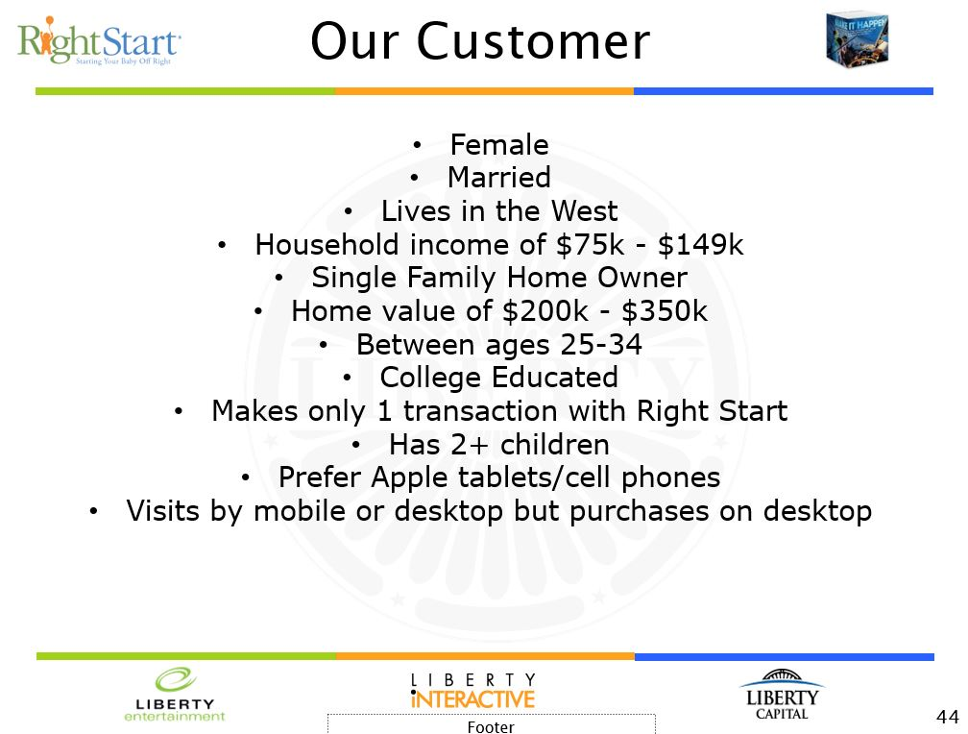

Slide 6
Ad Creation Continued…
Because of these insights, I emphasized several things about the UPPAbaby Vista 2015 stroller, including that they are:
  Compact, safe, easily transportable, the “best,” lightweight, include detachable bassinet, and can incorporate multiple children.

Slide 7
AD Creation Continued…
Customer base is upper-middle class women with multiple children. That is who Right Start needs to be targeting. Various “sale and discount” language can be deemphasized in favor of an emphasis on how light, easy and customizable the stroller can be – not to mention how it adapts to fit the needs of a perpetually growing family.

Slide 8
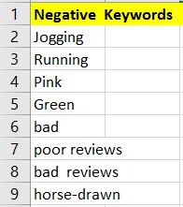
Negative Keywords
My negative keyword list is fairly self-explanatory.
  The stroller is not a stroller built for running or jogging.
  Pink and green are colors that are not available
  I don’t think Right Start wants its ads to show up when someone types in
  “bad reviews.”
  Lastly, Right Start does not want its ads for baby carriage to show up when someone types in “horse-drawn” from the term “horse-drawn carriage”

