Slide 1
RIGHT START: ANALYTICS AUDIT
Adam Mohrbacher
Search Engine Marketing
Professor Nick Neels

Slide 2
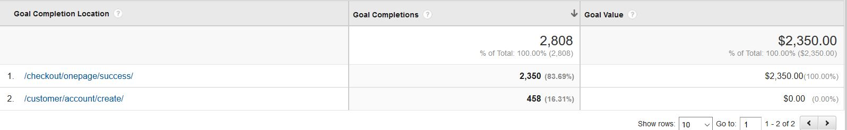
Pre-existing Tracked Conversions
Checkout Page
“Create Customer Account”

Slide 3
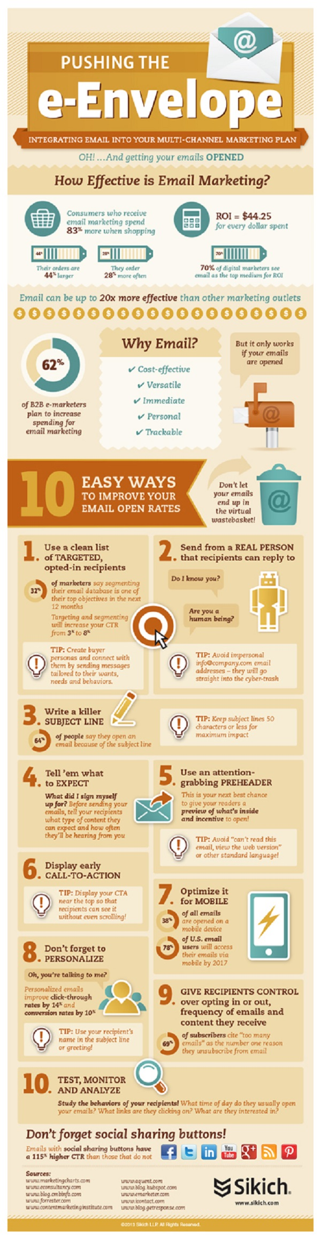
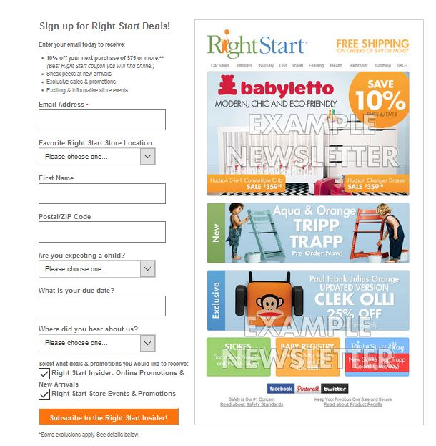
PROPOSED CONVERSIONS
1. Email Sign Up Page
Email sign ups is a critical conversion that Right Start needs to be tracking.
Email marketing can be an integral part of a consumer’s path to purchase.
“Social, mobile, email, text messaging, push messaging, apps—it's all part of the buying cycle, and it's all got to be tracked, which is what marketers have to spend a lot of their time doing these days.”¹
This is particularly true now when email marketing is able to be more segmented and relevant than ever before.
Also, in the age of the smart phone, people are theoretically always shopping. An email could be the start of the path to purchase.
Finally, email can play an important role in building long term relationships with customers. Not only can it help stimulate the path to purchase, an effective follow-up email can bring repeat business, creating a future path.
http://www.dmnews.com/direct-line-blog/off-the-beaten-path-to-purchase/article/303091/
https://visage.co/infographics-prove-value-email-marketing-data/
2

Slide 4
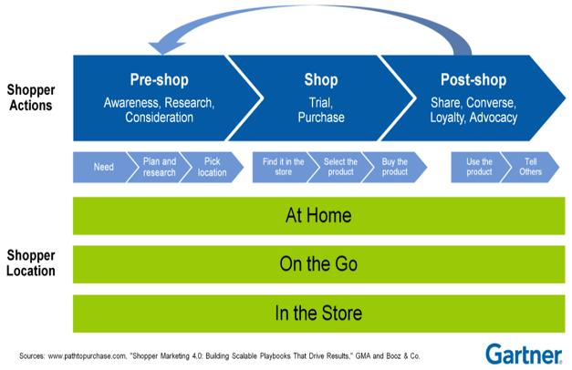
2. BABY Registry SIGN UPS
Registry sign ups is another conversion that needs to be tracked by analytics
Each time a registry is created it adds immense value
  Does this in two ways: Fiscally and through brand awareness
  Brings in numerous potential clients
Registries streamline the customer’s path to purchase!
Eliminates need to engage in pre-shopping actions.
Customers know right where to go to fulfill their need.
Need is to buy the consumer goods that a friend or family member wants.

Slide 5
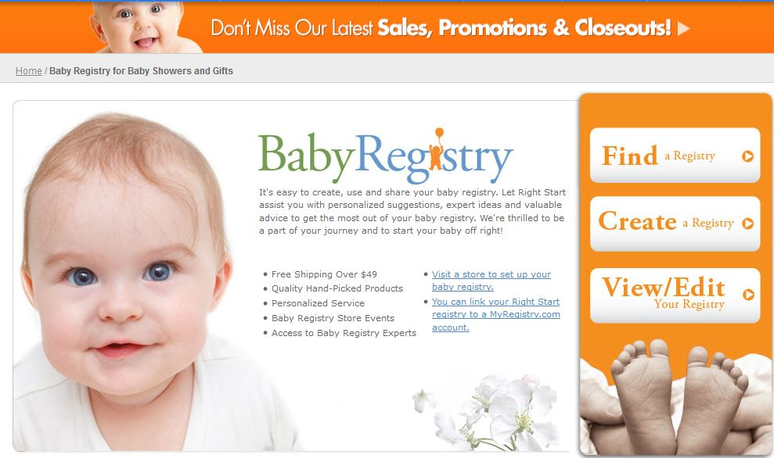
INTERVIEW ON REGISTRIES:
Have you ever used a registry?
A: Yes, I’ve used a registry for several weddings.
Why did you choose to use a registry?
A: It’s easier than spending time trying to figure out what to but. With a registry I know exactly what people want.
What did you like most about using a registry?
A: It’s nice when specific registries are easy to find, and when they
Are accessible through an app.³
3. (A. Lanz, personal communication, April 17, 2016)

Slide 6
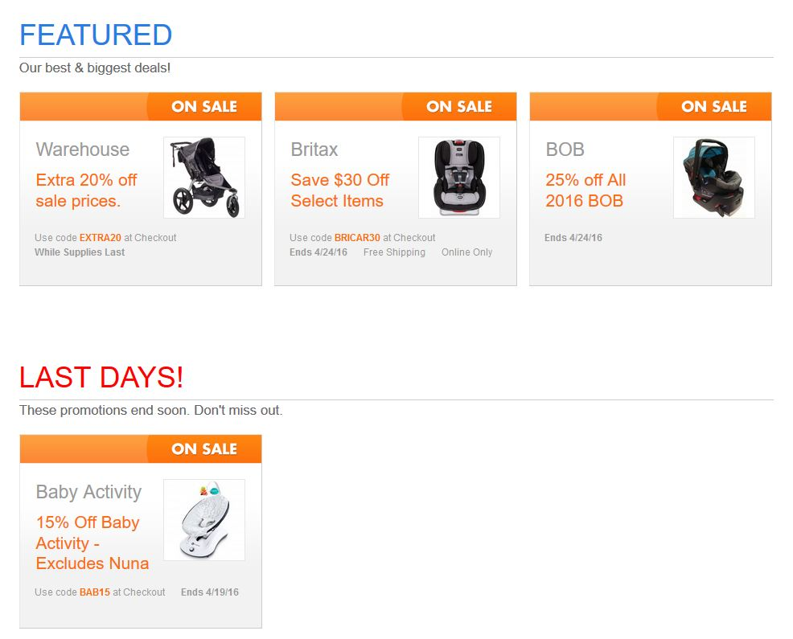
3. SALES PAGE
Tracking the site’s sales page is the final conversion goal that I will propose.
The site features heavily into Right Start’s overall site.
In many ways, their site feels like a collection of google ads.
Tracking which conversions they gain from this site is the way they will be able to judge the efficacy of these ads.
Adds value as it this page can stimulate consumer buying that might not occur if items were regular price.
Can help initiate path to purchase.

Slide 7
SUGGESTIONS FOR FEATURES/FUNCTIONALITY
Sales page: Poor design and layout. Ads do not include a “call to action,” nor do they truly illustrate savings ($45 Now $29)

